Slide 1
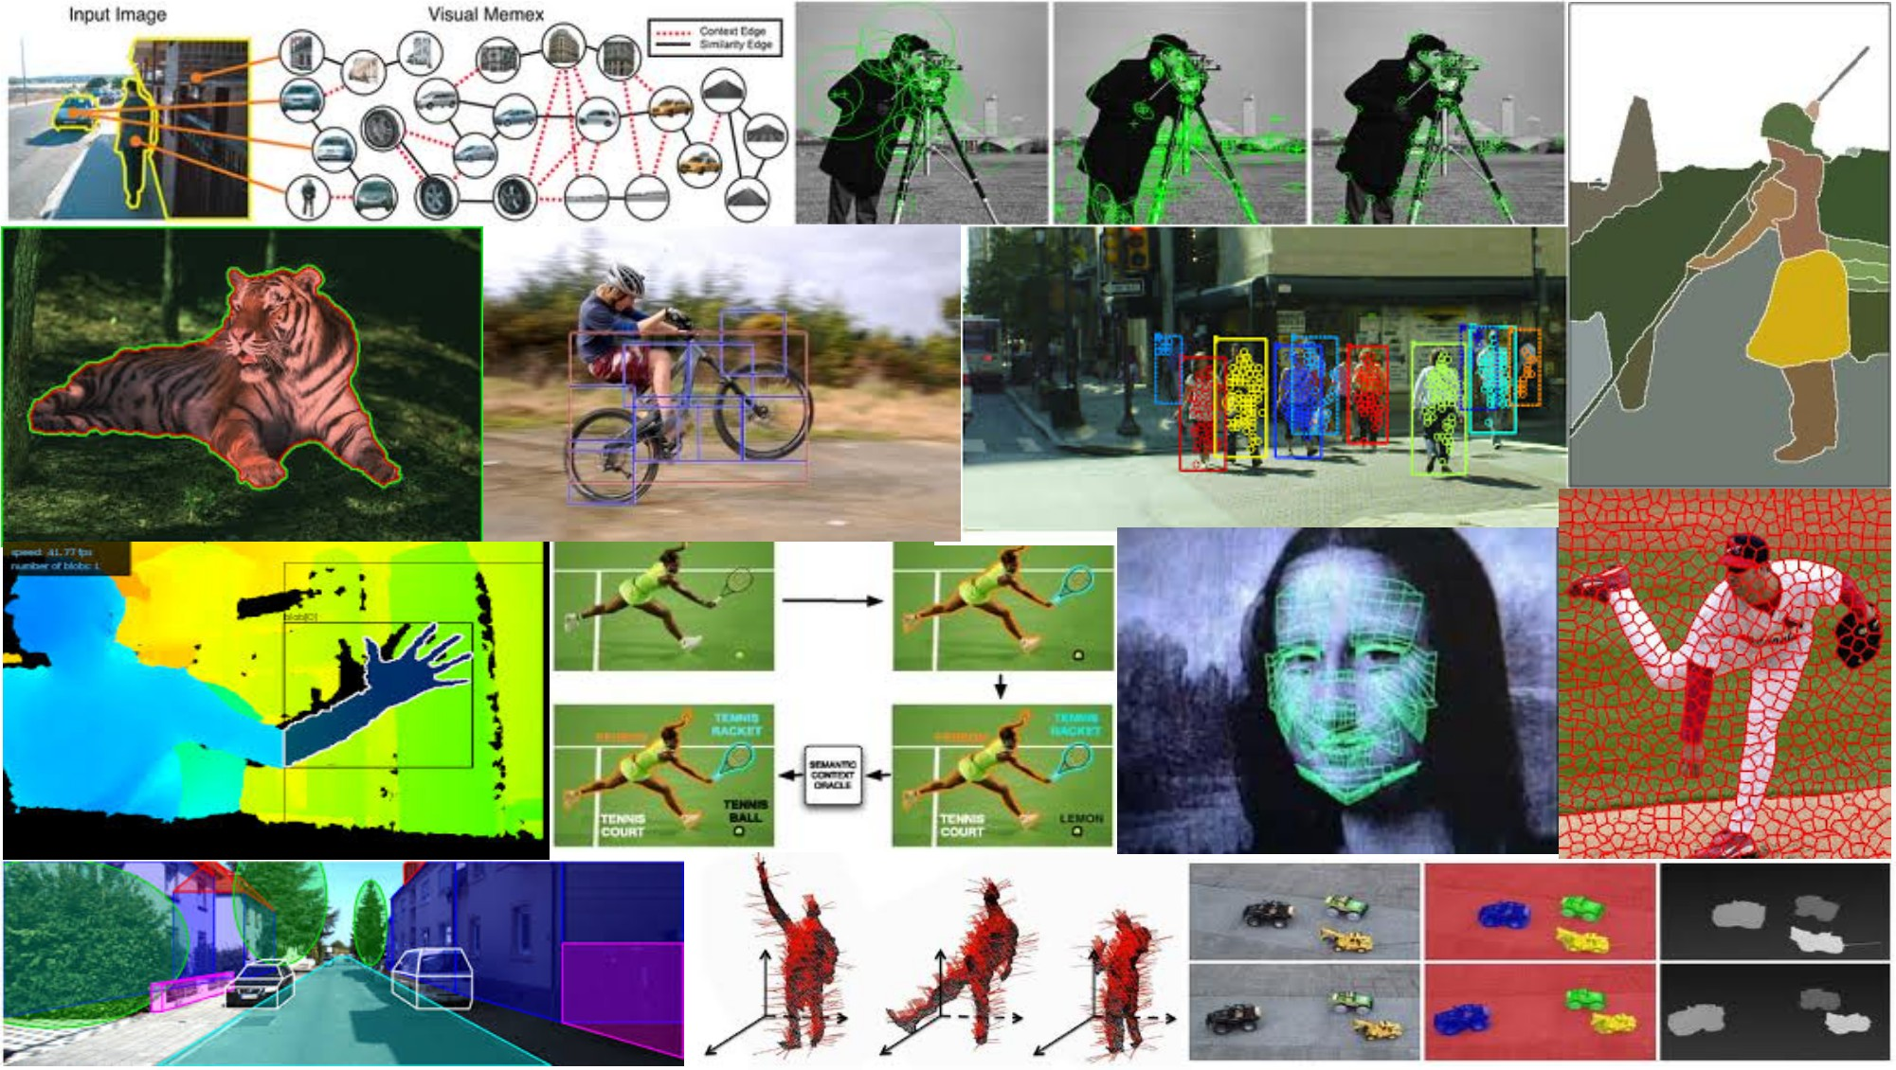
Image warping and stitching May 3rd, 2018
Yong Jae Lee
UC Davis

Slide 2
Last time
Interactive segmentation
Feature-based alignment
2D transformations
Affine fit
RANSAC

Slide 3
Alignment problem
In alignment, we will fit the parameters of some transformation according to a set of matching feature pairs (“correspondences”).
x_{i}
x_{i}
'
T
Slide credit: Adapted by Devi Parikh from Kristen Grauman

Slide 4
Main questions
Alignment: Given two images, what is the transformation between them?
T
Warping: Given a source image and a transformation, what does the transformed output look like?
T
Slide credit: Kristen Grauman

Slide 5
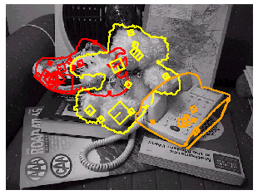
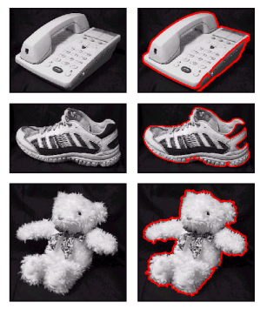
Motivation for feature-based alignment: Recognition
Figures from David Lowe

Slide 6
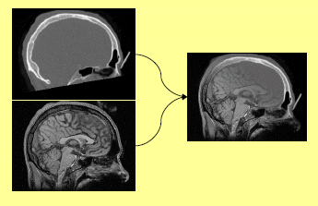
Motivation for feature-based alignment: Medical image registration
Slide credit: Kristen Grauman

Slide 7
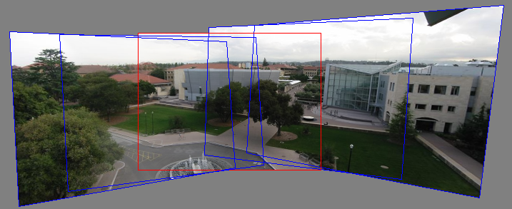
Motivation for feature-based alignment: Image mosaics
Image from http://graphics.cs.cmu.edu/courses/15-463/2010_fall/

Slide 8
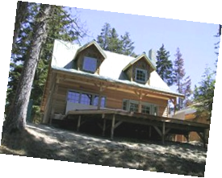
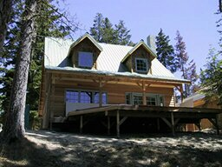
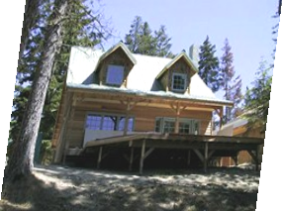
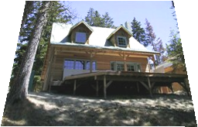
Parametric (global) warping
Examples of parametric warps:
translation
rotation
aspect
perspective
affine
Source: Alyosha Efros

Slide 9
Parametric (global) warping
T
p = (x,y)
p’ = (x’,y’)
Transformation T is a coordinate-changing machine:
p’ = T(p)
What does it mean that T is global?
Is the same for any point p
can be described by just a few numbers (parameters)
Let’s represent T as a matrix:
p’ = Mp
Source: Alyosha Efros

Slide 10
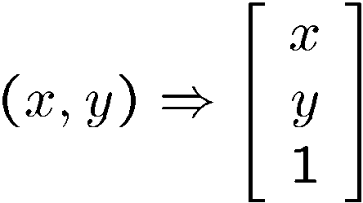
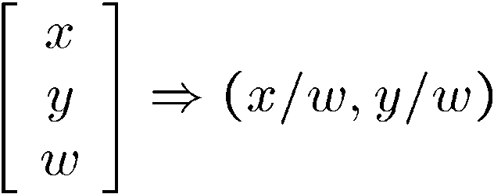
Homogeneous coordinates
To convert to homogeneous coordinates:
homogeneous image
coordinates
Converting from homogeneous coordinates
Slide credit: Kristen Grauman

Slide 11
2D Affine Transformations
Affine transformations are combinations of …
Linear transformations, and
Translations
Parallel lines remain parallel
Slide credit: Kristen Grauman

Slide 12
Projective Transformations
Projective transformations:
Affine transformations, and
Projective warps
Parallel lines do not necessarily remain parallel
Slide credit: Kristen Grauman

Slide 13
Fitting an affine transformation
Assuming we know the correspondences, how do we get the transformation?
Slide credit: Kristen Grauman

Slide 14
RANSAC: General form
RANSAC loop:
Randomly select a seed group of points on which to base transformation estimate (e.g., a group of matches)
Compute transformation from seed group
Find inliers to this transformation
If the number of inliers is sufficiently large, re-compute estimate of transformation on all of the inliers
Keep the transformation with the largest number of inliers
Slide credit: Kristen Grauman

Slide 15
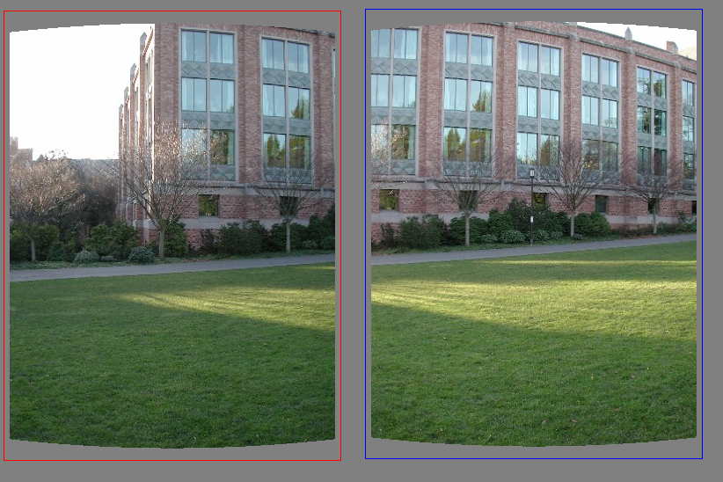
RANSAC example: Translation
Select one match, count inliers
Source: Rick Szeliski

Slide 16
RANSAC example: Translation
Select one match, count inliers

Slide 17
RANSAC example: Translation
Find “average” translation vector

Slide 18
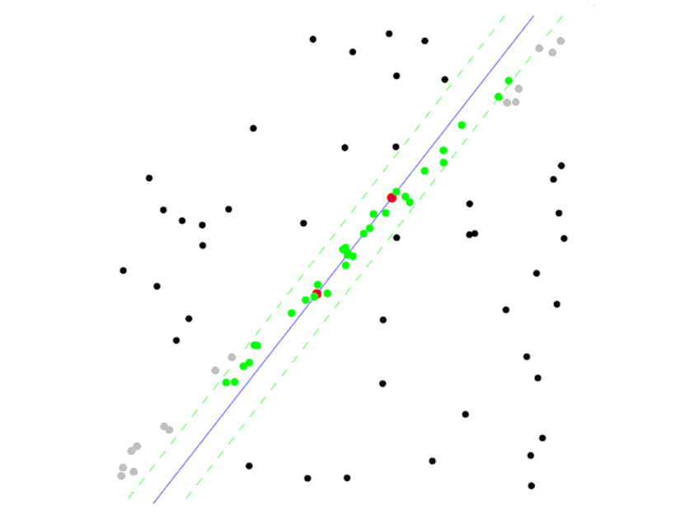
RANSAC pros and cons
Pros
Simple and general
Applicable to many different problems
Often works well in practice
Cons
Lots of parameters to tune
Doesn’t work well for low inlier ratios (too many iterations, or can fail completely)
Can’t always get a good initialization of the model based on the minimum number of samples
Lana Lazebnik

Slide 19
Today
Image mosaics
Fitting a 2D transformation
Homography
2D image warping
Computing an image mosaic

Slide 20
HP frames commercial
http://www.youtube.com/watch?v=2RPl5vPEoQk

Slide 21
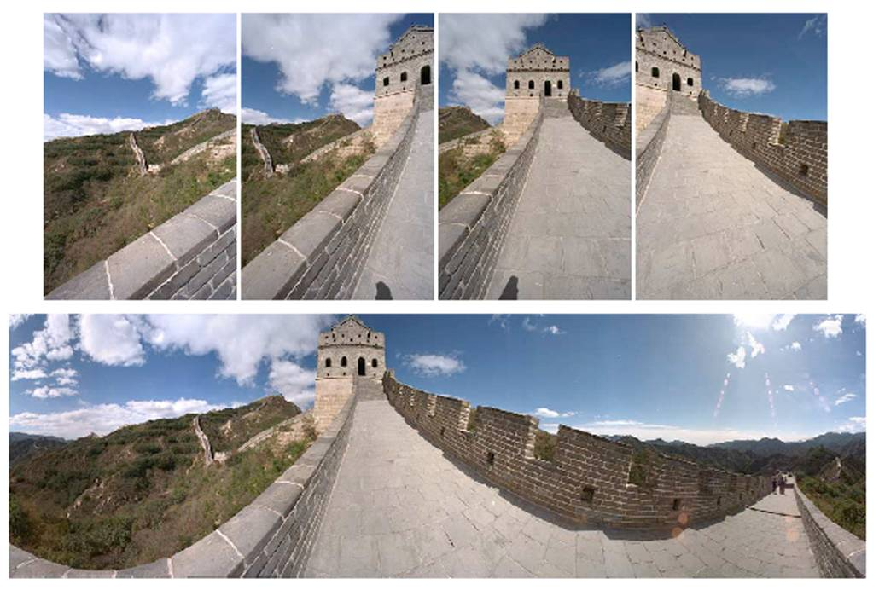

Mosaics
. . .
image from S. Seitz
Obtain a wider angle view by combining multiple images.
Slide credit: Kristen Grauman

Slide 22
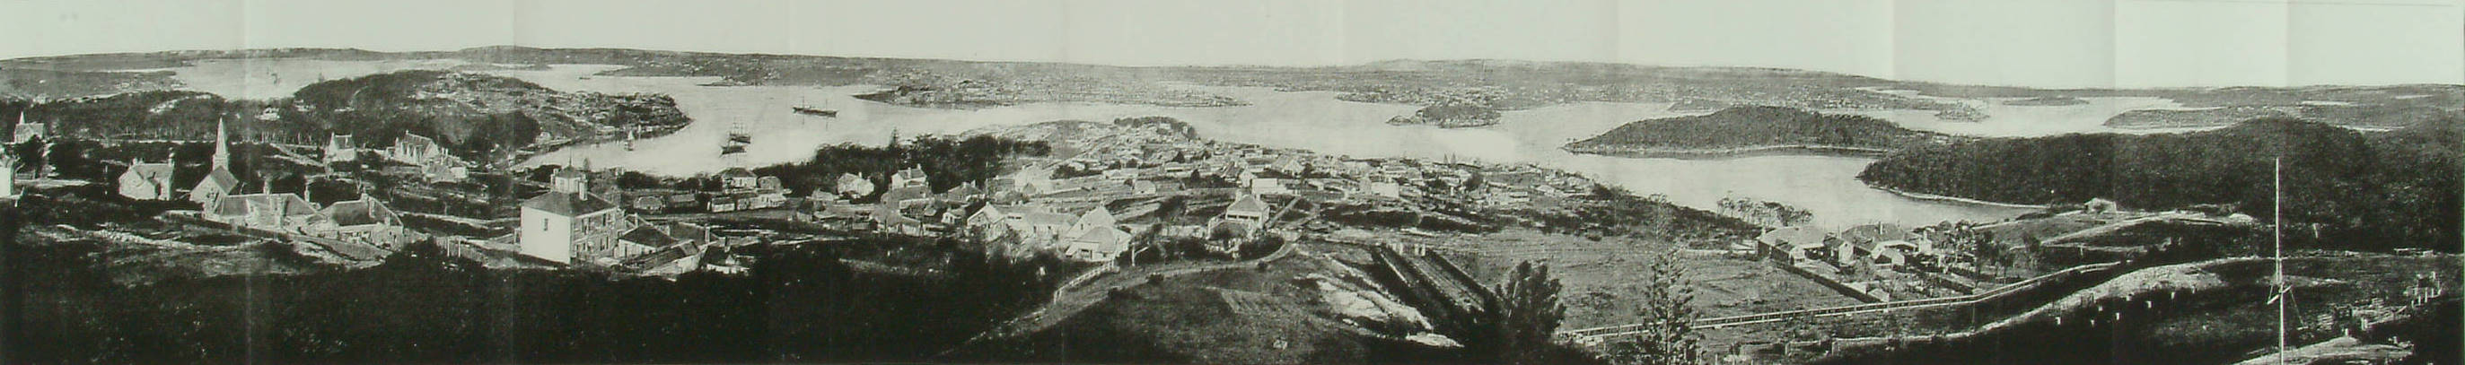
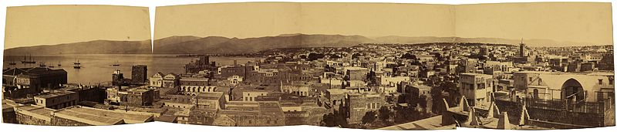
Panoramic Photos are old
Sydney, 1875
Beirut, late 1800’s
Slide credit: James Hays
Notes:
http://en.wikipedia.org/wiki/File:Historic_Sydney_Panorama.jpg

Slide 23
How to stitch together a panorama (a.k.a. mosaic)?
Basic Procedure
Take a sequence of images from the same position
Rotate the camera about its optical center
Compute transformation between second image and first
Transform the second image to overlap with the first
Blend the two together to create a mosaic
(If there are more images, repeat)
…but wait, why should this work at all?
What about the 3D geometry of the scene?
Why aren’t we using it?
Source: Steve Seitz
Notes:
If the sequence of images are taken from the same position (rotate the camera about its optical center), then the 3D geometry of the scene is NOT needed

Slide 24
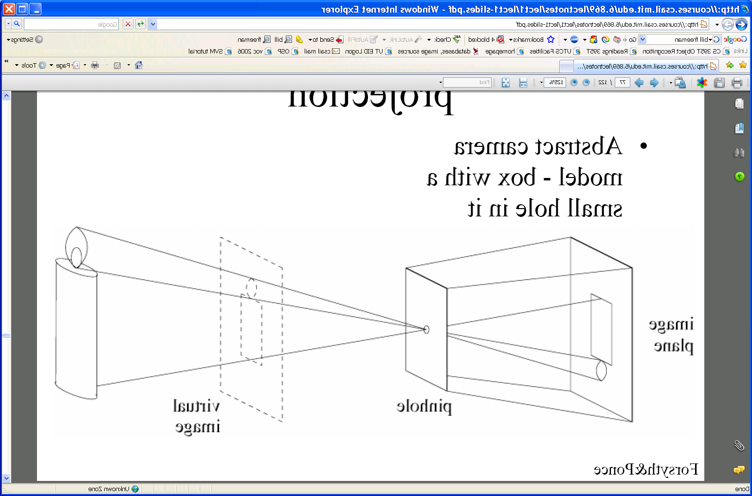
Pinhole camera
Pinhole camera is a simple model to approximate imaging process, perspective projection.
Image plane
Virtual image
pinhole
If we treat pinhole as a point, only one ray from any given point can enter the camera.
Slide credit: Kristen Grauman
Fig from Forsyth and Ponce
Notes:
Mathematically convenient model that approximates the imaging process.
Sometimes convenient to consider a (not inverted) virtual image at same distance from image plane in front of pinhole.

Slide 25
Mosaics: generating synthetic views
real
camera
synthetic
camera
Can generate any synthetic camera view
as long as it has the same center of projection!
Source: Alyosha Efros
Notes:
A pencil of rays contains all views from same center of projection

Slide 26
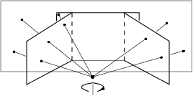
Mosaics
. . .
image from S. Seitz
Obtain a wider angle view by combining multiple images.
Slide credit: Kristen Grauman

Slide 27
Image reprojection
mosaic Projective Plane (PP)
The mosaic has a natural interpretation in 3D
The images are reprojected onto a common plane
The mosaic is formed on this plane
Mosaic is a synthetic wide-angle camera
Source: Steve Seitz

Slide 28
Image reprojection
Basic question
How to relate two images from the same camera center?
how to map a pixel from PP1 to PP2
PP2
Answer
Cast a ray through each pixel in PP1
Draw the pixel where that ray intersects PP2
Observation:
Rather than thinking of this as a 3D reprojection, think of it as a 2D image warp from one image to another.
PP1
Source: Alyosha Efros

Slide 29
Image reprojection: Homography
A projective transform is a mapping between any two PPs with the same center of projection
rectangle should map to arbitrary quadrilateral
parallel lines aren’t preserved
but must preserve straight lines
called Homography
PP2
PP1
p’
H
p
Source: Alyosha Efros

Slide 30
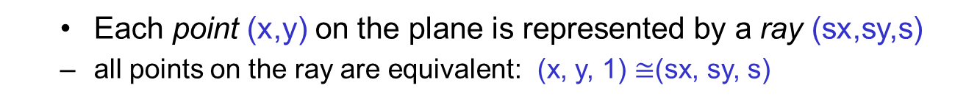
The projective plane
Why do we need homogeneous coordinates?
represent points at infinity, homographies, perspective projection, multi-view relationships
What is the geometric intuition?
a point in the image is a ray in projective space
-y
(sx,sy,s)
(x,y,1)
(0,0,0)
-z
x
image plane
Each point (x,y) on the plane is represented by a ray (sx,sy,s)
all points on the ray are equivalent: (x, y, 1) $≅$(sx, sy, s)

Slide 31
Homography
…
…
To compute the homography given pairs of corresponding points in the images, we need to set up an equation where the parameters of H are the unknowns…
Slide credit: Kristen Grauman

Slide 32
Solving for homographies
p’ = Hp
Upto a scale factor.
Constraint Frobenius norm of H to be 1.
Problem to be solved:
where vector of unknowns h = [h₀₀,h₀₁,h₀₂,h₁₀,h₁₁,h₁₂,h₂₀,h₂₁,h₂₂]^{T}
Notes:
There is a whole set of solution homographies with variation across scale.

Slide 33
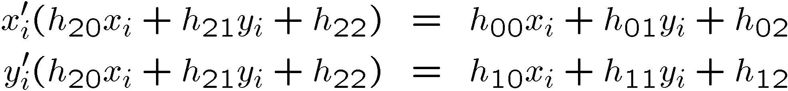
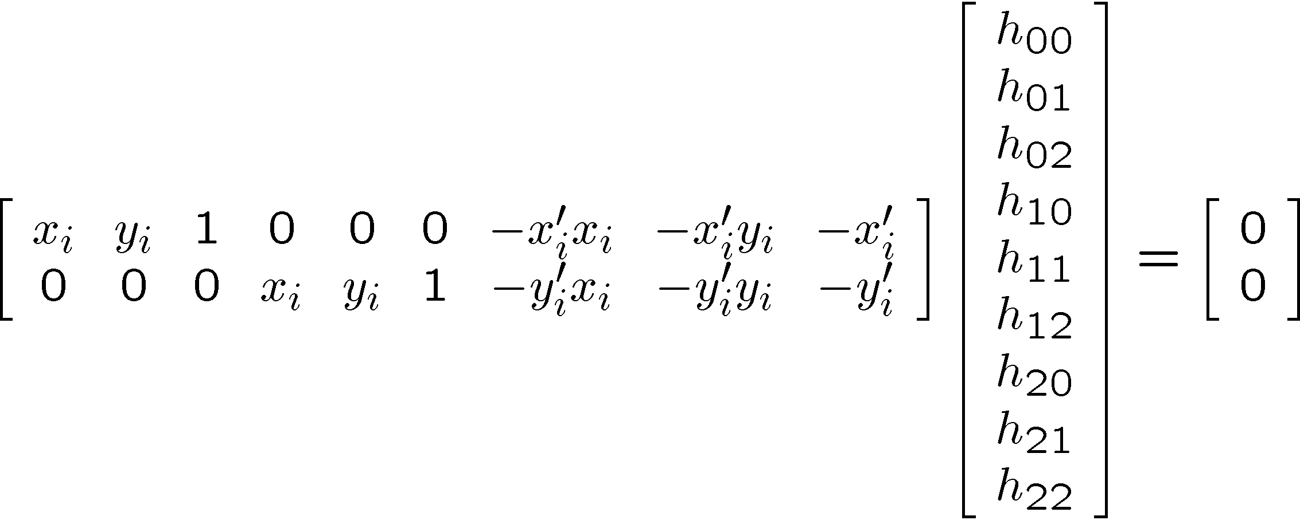
Solving for homographies

Slide 34
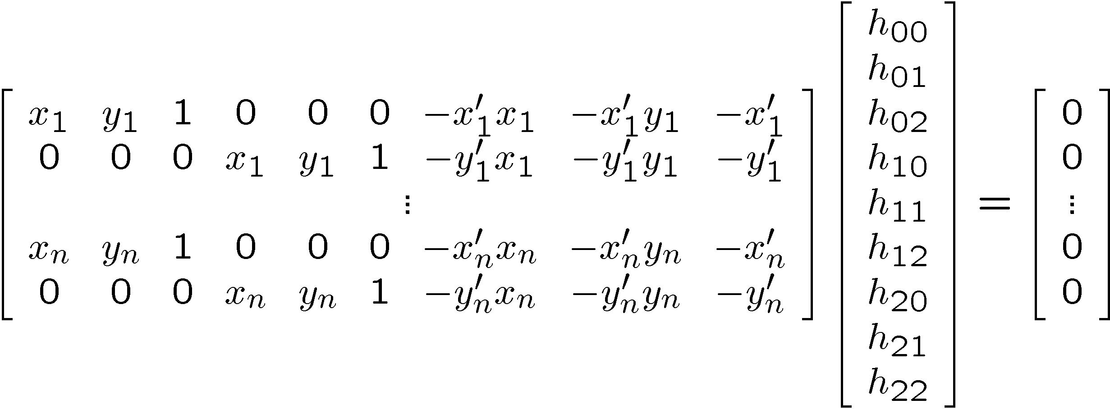

Solving for homographies
A
h
0
2n × 9
9
2n
Defines a least squares problem:
Since h is only defined up to scale, solve for unit vector ĥ
Solution: ĥ = eigenvector of A^{T}A with smallest eigenvalue
Works with 4 or more points

Slide 35
Homography
To apply a given homography H
Compute p’ = Hp (regular matrix multiply)
Convert p’ from homogeneous to image coordinates
p’
H
p
Slide credit: Kristen Grauman

Slide 36
Today
RANSAC for robust fitting
Lines, translation
Image mosaics
Fitting a 2D transformation
Homography
2D image warping
Computing an image mosaic

Slide 37
Image warping
T(x,y)
y
y’
x
x’
f(x,y)
g(x’,y’)
Given a coordinate transform and a source image f(x,y), how do we compute a transformed image g(x’,y’) = f(T(x,y))?
Slide from Alyosha Efros

Slide 38
Forward warping
T(x,y)
y
y’
x
x’
f(x,y)
g(x’,y’)
Send each pixel f(x,y) to its corresponding location
(x’,y’) = T(x,y) in the second image
Q: what if pixel lands “between” two pixels?
Slide from Alyosha Efros

Slide 39
Forward warping
T(x,y)
y
y’
x
x’
f(x,y)
g(x’,y’)
Send each pixel f(x,y) to its corresponding location
(x’,y’) = T(x,y) in the second image
Q: what if pixel lands “between” two pixels?
A: distribute color among neighboring pixels (x’,y’)
Known as “splatting”
Slide from Alyosha Efros

Slide 40
Inverse warping
T⁻¹(x,y)
y
y’
x
x
x’
f(x,y)
g(x’,y’)
Get each pixel g(x’,y’) from its corresponding location
(x,y) = T⁻¹(x’,y’) in the first image
Q: what if pixel comes from “between” two pixels?
Slide from Alyosha Efros

Slide 41
Inverse warping
T⁻¹(x,y)
y
y’
x
x
x’
f(x,y)
g(x’,y’)
Get each pixel g(x’,y’) from its corresponding location
(x,y) = T⁻¹(x’,y’) in the first image
Q: what if pixel comes from “between” two pixels?
A: Interpolate color value from neighbors
nearest neighbor, bilinear…
>> help interp2
Slide from Alyosha Efros

Slide 42





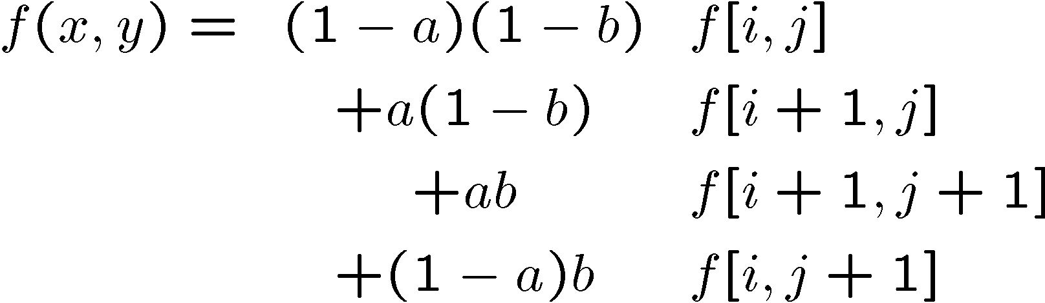
Bilinear interpolation
Sampling at f(x,y):
Slide from Alyosha Efros

Slide 43
Recap: How to stitch together a panorama (a.k.a. mosaic)?
Basic Procedure
Take a sequence of images from the same position
Rotate the camera about its optical center
Compute transformation (homography) between second image and first using corresponding points.
Transform the second image to overlap with the first.
Blend the two together to create a mosaic.
(If there are more images, repeat)
Source: Steve Seitz

Slide 44
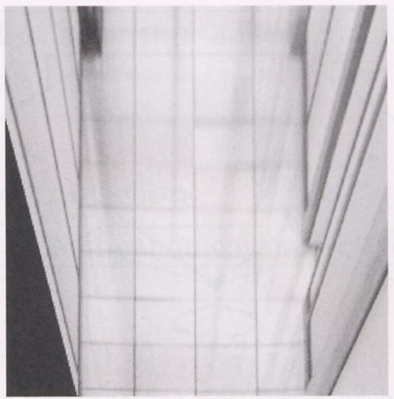
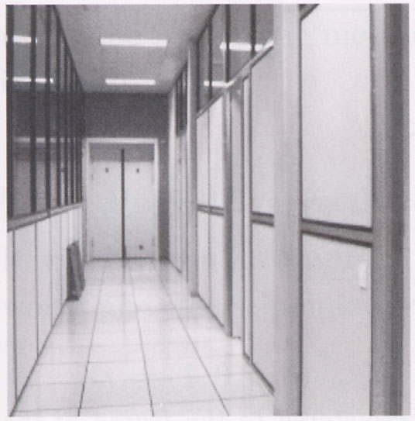
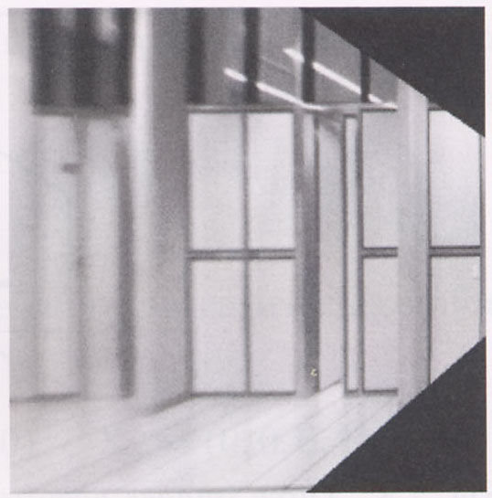
Image warping with homographies
image plane in front
image plane below
black area
where no pixel
maps to
Source: Steve Seitz

Slide 45
Image rectification
p’
p
Slide credit: Kristen Grauman

Slide 46
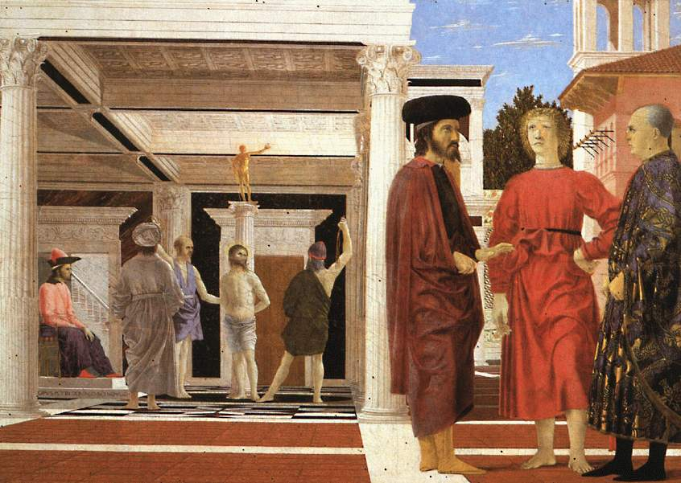
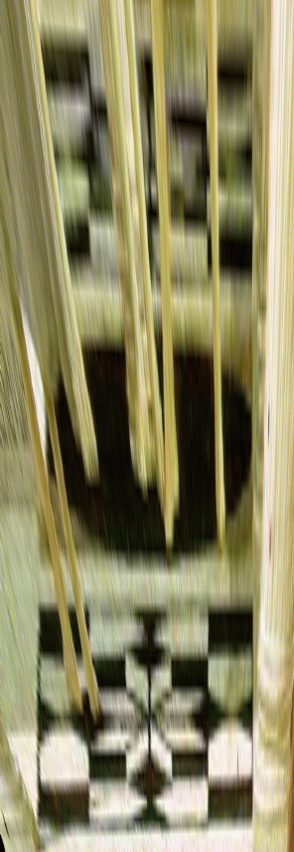
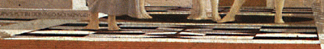
Analysing patterns and shapes
What is the shape of the b/w floor pattern?
Homography
The floor (enlarged)
Automatically
rectified floor
Slide from Antonio Criminisi

Slide 47
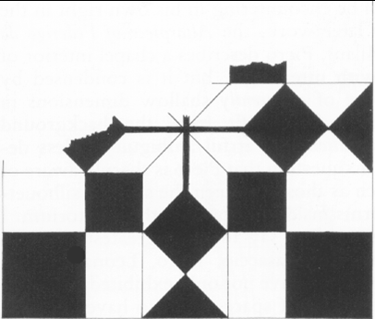
Analysing patterns and shapes
Automatic rectification
From Martin Kemp The Science of Art
(manual reconstruction)
Slide from Antonio Criminisi

Slide 48
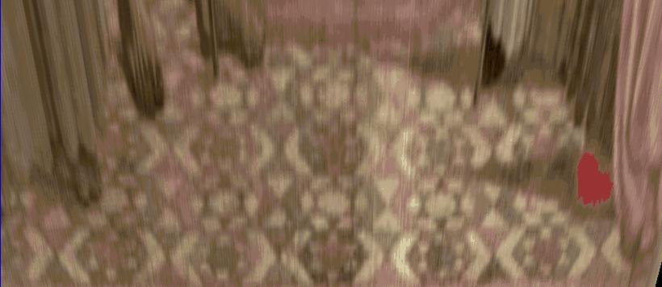
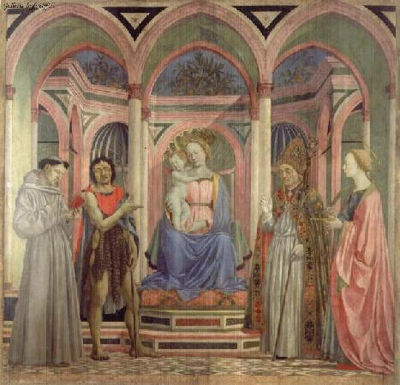
Analysing patterns and shapes
What is the (complicated)
shape of the floor pattern?
Automatically rectified floor
St. Lucy Altarpiece, D. Veneziano
Slide from Criminisi

Slide 49
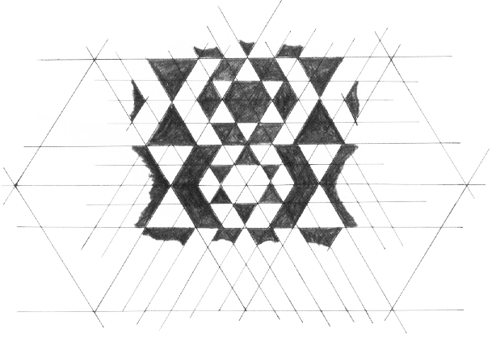
Analysing patterns and shapes
Automatic
rectification
From Martin Kemp, The Science of Art
(manual reconstruction)
Slide from Criminisi

Slide 50
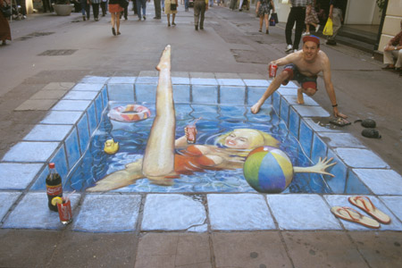
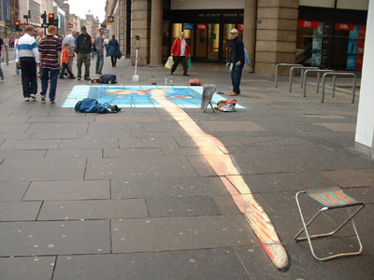
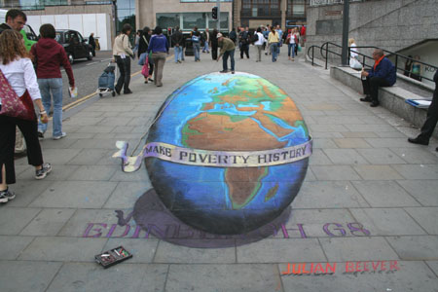
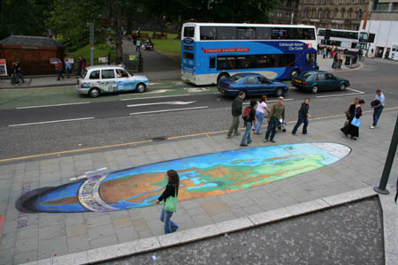
Julian Beever: Manual Homographies
http://users.skynet.be/J.Beever/pave.htm

Slide 51
Changing camera center
Does it still work?
synthetic PP
PP1
PP2
Source: Alyosha Efros

Slide 52
Recall: same camera center
real
camera
synthetic
camera
Can generate synthetic camera view
as long as it has the same center of projection.
Source: Alyosha Efros

Slide 53
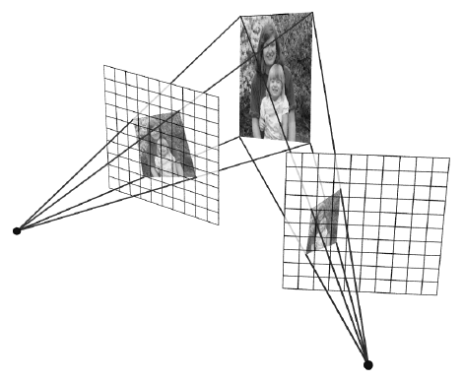
…Or: Planar scene (or far away)
PP3
PP1
PP2
PP3 is a projection plane of both centers of projection, so we are OK!
This is how big aerial photographs are made
Source: Alyosha Efros

Slide 54
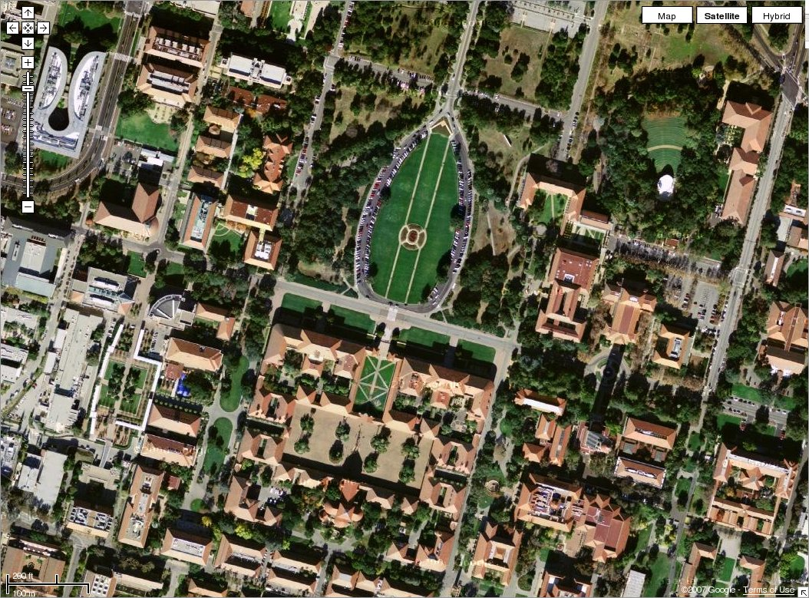

Slide 55
RANSAC for estimating homography
RANSAC loop:
1. Select four feature pairs (at random)
2. Compute homography H (exact)
3. Compute inliers where SSD(p_{i}’, Hp_{i})< ε
4. Keep largest set of inliers
5. Re-compute least-squares H estimate on all of the inliers
Slide credit: Steve Seitz

Slide 56


Robust feature-based alignment
Source: L. Lazebnik

Slide 57


Robust feature-based alignment
Extract features
Source: L. Lazebnik

Slide 58
Robust feature-based alignment
Extract features
Compute putative matches
Source: L. Lazebnik

Slide 59
Robust feature-based alignment
Extract features
Compute putative matches
Loop:
Hypothesize transformation T (small group of putative matches that are related by T)
Source: L. Lazebnik

Slide 60
Robust feature-based alignment
Extract features
Compute putative matches
Loop:
Hypothesize transformation T (small group of putative matches that are related by T)
Verify transformation (search for other matches consistent with T)
Source: L. Lazebnik

Slide 61

Robust feature-based alignment
Extract features
Compute putative matches
Loop:
Hypothesize transformation T (small group of putative matches that are related by T)
Verify transformation (search for other matches consistent with T)
Source: L. Lazebnik

Slide 62
Summary: alignment & warping
Write 2d transformations as matrix-vector multiplication (including translation when we use homogeneous coordinates)
Fitting transformations: solve for unknown parameters given corresponding points from two views (affine, projective (homography)).
Perform image warping (inverse)
Mosaics: uses homography and image warping to merge views taken from same center of projection.
Slide credit: Kristen Grauman

Slide 63
Next time: which features should we match?
Slide credit: Kristen Grauman

Slide 64
Questions?

